Slide 1
AI@Penn – Session 1

Slide 2
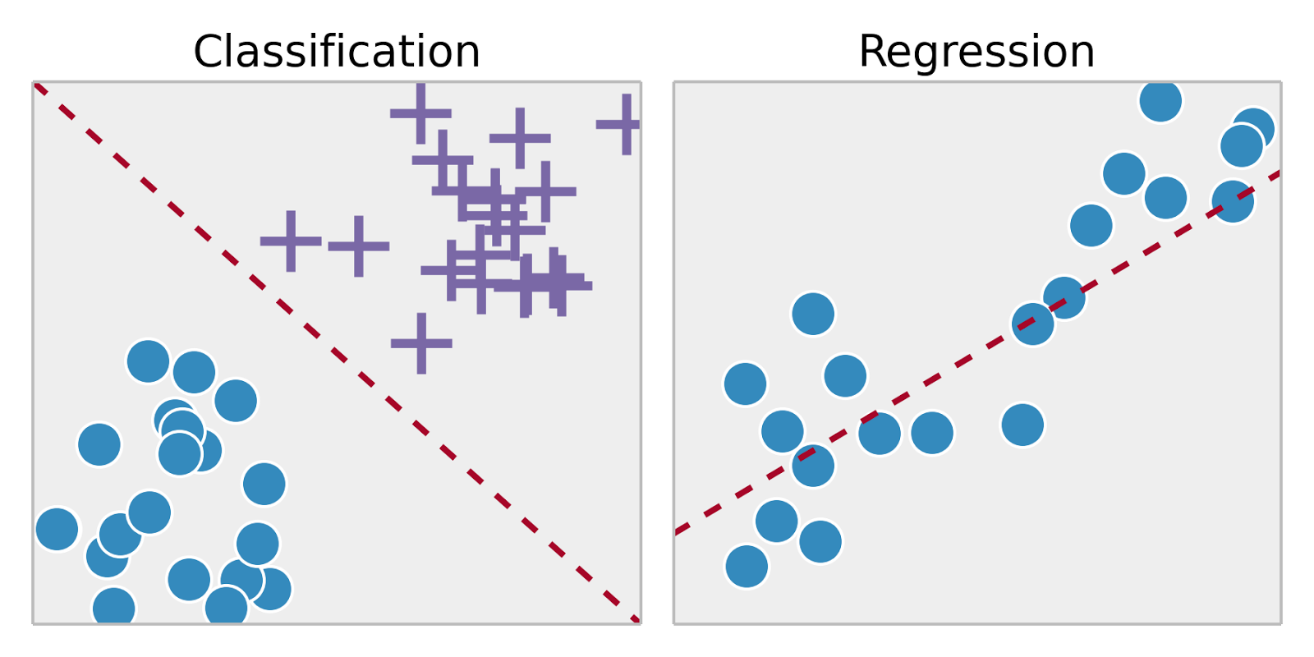
Classification vs Regression Tasks
Supervised: labelled data (eg. house prices), Unsupervised: unlabelled data (eg. bank customer data)
Classification: predicting discrete outcome (eg. handwritten digit), Regression: predicting continuous outcome (eg. house prices)
Classification requires distinct sets, and each piece of training data must belong to one

Slide 3
Process of Supervised Machine Learning
Compile/find dataset → example social media advertisement success dataset (instances, features, output value, predicted value)
Split dataset into train and test
Create algorithm framework
Feed data from dataset to algorithm using training data (training phase)
Evaluate performance of algorithm using test data (testing phase)

Slide 4
Credit Default Prediction Algorithm
Import libraries
Read data
Separate into features and output values
Train-test split
Feed data into algorithm to train
Test performance

Slide 5
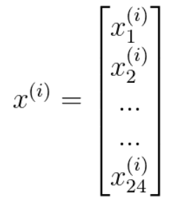
Logistic Regression (I)
In essence, an optimal, weighted summation of all the features
Example of this weighting
Dataset represented as:
Feature vector for single training instance i:
Output value: 0 (no cancer) or 1 (cancer)

Slide 6
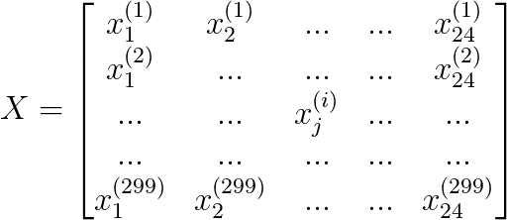
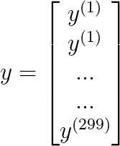
Logistic Regression (II)
Dataset now split up and represented as matrix:
Logistic Regression predicts probabilities rather than the actual value (eg. difference between strong vs weak prediction)
If (ŷ > 0.5), predict 1, or else predict 0

Slide 7
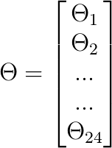
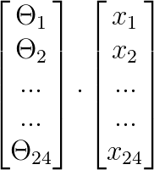
Logistic Regression (III)
Weightings stored in weights vector:
To get weighted sum, utilize dot product (represented as Θ^{T}x)

Slide 8
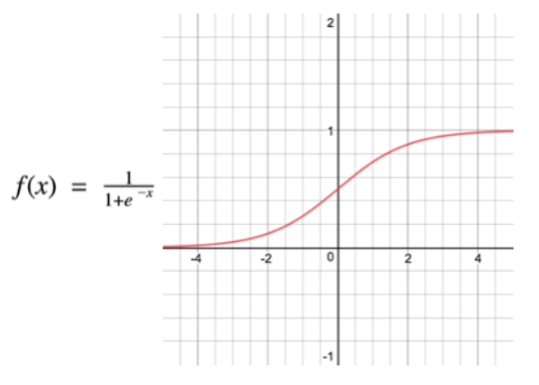
Logistic Regression (IV)
However, this gives an infinite result
Thus, sigmoid function utilized to bound output to be between 0 and 1 (like any regular probability)
High weighted sum → high probability
Low weighted sum → low probability
Weighted sum = 0 → 0.5 probability
The input to the function is the weighted sum, Θ^{T}x
So f(x) is represented as….

Slide 9
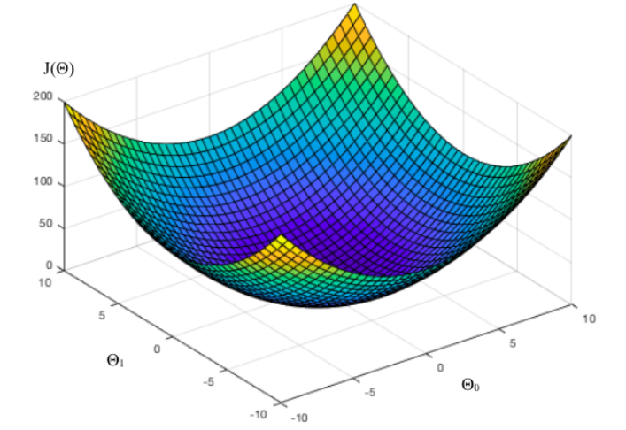
Logistic Regression (V)
Utilize h_{Θ}(x) instead, since weighted sum is dependent on values in Θ
How do we find the ideal values for Θ?
First, gauge how well the model does → Cost Function
Mean Squared Error function parameterized by all variables in Θ → can be seen as a graph in many dimensions, which each dimension representing a weight

